Slide 1
Competence Profile of the Enterprise Architect

Slide 2
Enterprise Architects: Positioning
Governance
Business – IT Alignment
Enterprise Architects
Business-
Technology
Strategy
Enterprise Architects
Enterprise Architecture
Solution
Design
Solution Architecture
Solution Architects (2 types)
Business & Information Architects
Solution Architects
Information-Systems & Technology-Infrastructure Architects
Business
Information
Information Systems
Technology Infrastructure
Solution
Delivery
Software Architects
Software Engineers
Supply Chain
Management
BPM / CRM / ERP
Workflow Analysis
Information
Analysis
Software
Architecture
Security
Architecture
Information Analysts
Data
Architecture
Network
Architecture
Security Specialists
Process Developers
Governance Specialists
(C) Copyrights IFEAD, 2001-2008

Slide 3
About The Enterprise Architect …..
First of all . . . It is not a Saint that can solve all your issues.
You can’t become an Enterprise Architect after following a course or training.
Enterprise Architects have a long experience in business as well as in technology areas.
Enterprise Architects must have different capabilities.
Enterprise Architects must play different roles.
Enterprise Architects are familiar with different methodologies & techniques.
Enterprise Architects are Communicators.
(C) Copyrights IFEAD, 2001-2008
Notes:
Human Factors in EA
Conflicts
Schedules, delays, differing priorities and requirements
Insufficient data
Specifications
Funding
Poor communications
Leadership in EA
Knowing and Using Resources
Communications
Planning
Controlling the group
Representing the group
Evaluating
Sharing leadership
Setting the example
Why Sell Architecture?
EA is not well understood
It’s an investment
What is the value?
You need sponsorship and support
Many forces arrayed against you
Have to sell over and over again
Your Goals
Disarm your foes; get other selling for you; obtain agreement on developing and continuing EA work.
The Message
Avoid negative issues; we’re not broken, dysfunctional . . . No one listens to complainers.
Focus on the positive: Offer solutions, continuous improvement is the goal.
What’s in it for the state: benefits and services to citizens; to the state; cost avoidances and savings

Slide 4

Overall Profile of the Enterprise Architect
Business Responsibilities
  Understanding business objectives, drivers & principles
  Good sense of business and technical strategy to envision the “right” enterprise architectural approach to the problem set
  Creating visualisations & models, supports decision making
  Ability to communicate and mentor others
  “Selling” and leadership qualities
Technology Responsibility
  Articulating the Enterprise Architectural vision
  Conceptualising and experimenting with alternative enterprise architectural approaches
  Creating landscape models and component and interface specification results
  Validating the enterprise architecture against requirements and assumptions
(C) Copyrights IFEAD, 2001-2008

Slide 5
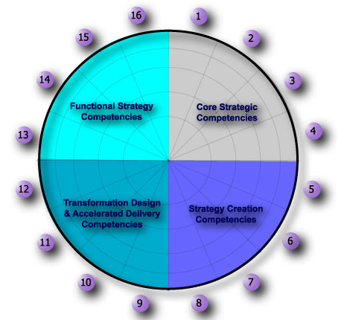
Enterprise Architects Competence Profile – Level 5
Soft Skills & techniques
Business Technology
Strategy development
EA Capabilities Development
Organisational Politics behaviour
Expert
Practitioner
Domain and pertinent technologies knowledge
Stakeholder Analysis
Knowledge
None
Enterprise Architecture Maturity & Diagnostics
Functional EA Competences
Core EA Competences
Leadership & Coaching
EA Delivery Competences
EA Creation Competences
Business Case Design & Tracking
EA Awareness Formulation
None
Knowledge
EA Modelling & Techniques
EA Program Definition
Practitioner
EA Programs & Management
Expert
Vision / Strategic Intent EA Requirements
Visioning / Mapping
the Enterprise Architecture Frameworks
Accelerating Market Knowledge
(C) Copyrights IFEAD, 2001-2008

Slide 6
Enterprise Architects Competence Profile – Level 4
Soft Skills & techniques
Business Technology
Strategy development
EA Capabilities Development
Organisational Politics behaviour
Expert
Practitioner
Domain and pertinent technologies knowledge
Stakeholder Analysis
Knowledge
None
Enterprise Architecture Maturity & Diagnostics
Functional EA Competences
Core EA Competences
Leadership & Coaching
EA Delivery Competences
EA Creation Competences
Business Case Design & Tracking
EA Awareness Formulation
None
Knowledge
EA Modelling & Techniques
EA Program Definition
Practitioner
EA Programs & Management
Expert
Vision / Strategic Intent EA Requirements
Visioning / Mapping
the Enterprise Architecture Frameworks
Accelerating Market Knowledge
(C) Copyrights IFEAD, 2001-2008

Slide 7
Enterprise Architects Competence Profile – Level 3
Soft Skills & techniques
Business Technology
Strategy development
EA Capabilities Development
Organisational Politics behaviour
Expert
Practitioner
Domain and pertinent technologies knowledge
Stakeholder Analysis
Knowledge
None
Enterprise Architecture Maturity & Diagnostics
Functional EA Competences
Core EA Competences
Leadership & Coaching
EA Delivery Competences
EA Creation Competences
Business Case Design & Tracking
EA Awareness Formulation
None
Knowledge
EA Modelling & Techniques
EA Program Definition
Practitioner
EA Programs & Management
Expert
Vision / Strategic Intent EA Requirements
Visioning / Mapping
the Enterprise Architecture Frameworks
Accelerating Market Knowledge
(C) Copyrights IFEAD, 2001-2008

Slide 8
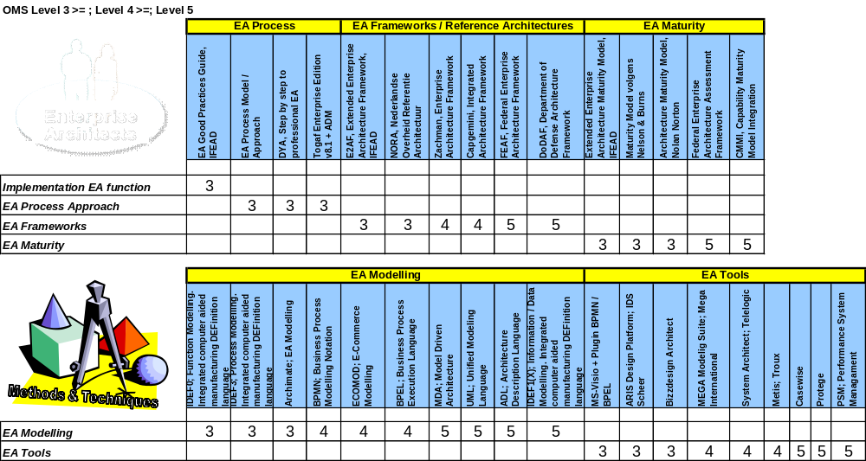
EA Capabilities & Competence Levels Matrix, Methods & Techniques
(C) Copyrights IFEAD, 2001-2008

Slide 9
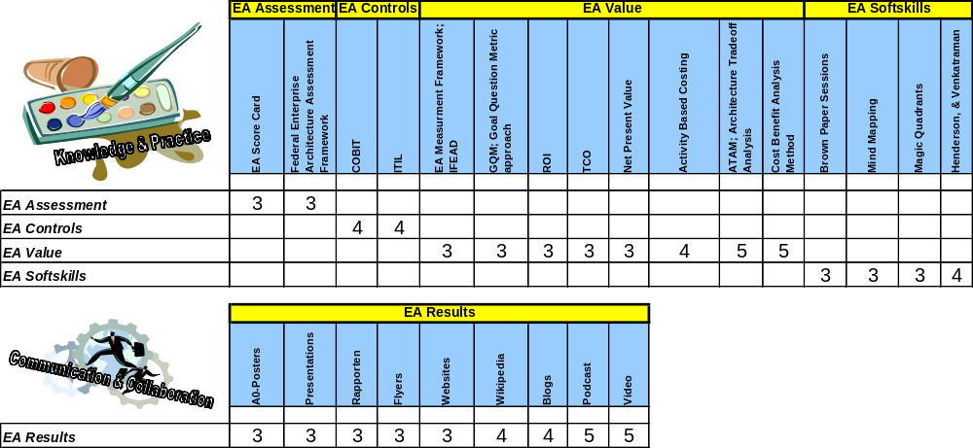
EA Capabilities & Competence Levels Matrix, Methods & Techniques, Cont.
(C) Copyrights IFEAD, 2001-2008

Slide 10
Explanation Competence Statements
Business Technology
Strategy development
Organisational Politics behaviour
Domain and pertinent technologies knowledge
Leadership & Coaching
EA Awareness Formulation
EA Program Definition
Vision / Strategic Intent, EA Requirements
Accelerating Market Knowledge
Visioning / Mapping the Enterprise Architecture Frameworks
EA Programs & Management
EA Modelling & Techniques
Business Case Design & Tracking
Enterprise Architecture Maturity & Diagnostics
Stakeholder Analysis
EA Capabilities Development
Soft Skills & techniques
Are you able to develop a Business Technology Strategy
Are you familiar and able to deal with in a strong organisational & political behaving environment
Do you have knowledge about domain specific technologies and pertinent common technologies
Are you able to manifest EA Leadership and Coaching
Are you able to show and formulate EA awareness
Are you able to define an Enterprise Architecture Program
Are you able to translate the Business vision and strategic intention into EA requirements
Are you able to quickly adopt specific market / branch knowledge
Are you able to translate the Business Vision to Enterprise Architecture Frameworks
Are you able to manage and Enterprise Architecture Program
Are you familiar with the most common Business, Information, Information-Systems and Infrastructure modelling techniques
Are you able to set up and design a business case and track the results over time
Are you able to define an organisations EA maturity and diagnoses the appropriate approach
Are you able to do a stakeholder analysis e.q. based on the win-win theory
Are you able to define and develop the necessary EA capabilities for a customer
Are you familiar and can you demonstrate the necessary Soft skills & techniques in different situations.
(C) Copyrights IFEAD, 2001-2008

Slide 11

Enterprise Architect Role Profile: Business Technology Strategy
What You Know
  Your organisation’s business & technology strategy and Rationale
  Your competition(products, strategies and processes)
  Your company’s business practices
  Your Technology Portfolio
What You Do
  Influence business strategy
  Translate business strategy into technical vision and strategy
  Understand customer and market trends
  Capture customer, organisational and business requirements of architecture
  Prepare architectural documents and presentations
What You Are
  Visionary
  Entrepreneurial
Your = the Customers
(C) Copyrights IFEAD, 2001-2008

Slide 12

Enterprise Architect Role Profile: Organisational Politics
What You Know
  Who the key players are in the organisation
  What they want, both business and personal
What You Do
  Communicate, communicate, communicate
  Listen, network, influence
  Sell the vision, keep the vision alive
  Take and retake the pulse of all critical influencers of the architecture project
What You Are
  Able to see from and sell to multiple viewpoints
  Confident and articulate
  Ambitious and driven
  Patient and not
  Resilient
  Sensitive to where the power is and how if flows in your organisation
(C) Copyrights IFEAD, 2001-2008

Slide 13

Enterprise Architect Role Profile: Consulting
What You Know
  Elicitation techniques
  Consulting frameworks
  Soft Skill techniques
What You Do
  Build “trusted advisor” relationship
  Understand what the business people want and need from the architecture
  Understand what the developers want and need from the architecture
  Help developers see the value of the enterprise architecture and understand how to use technology successfully
  Mentor junior architects
What You Are
  Committed to others’ success
  Empathetic, approachable
  An effective change agent, process savvy
  A good mentor, teacher
(C) Copyrights IFEAD, 2001-2008

Slide 14

Enterprise Architect Role Profile: Leadership
What You Know
  Yourself
What You Do
  Set team context (vision)
  Make decisions (stick)
  Build teams
  Motivate
What You Are
  You and others see you as a leader
  Charismatic and credible
  You believe it can and should be done, and that you can lead the effort
  Committed, dedicated, passionate
  You see the entire effort in a broader business and personal context
(C) Copyrights IFEAD, 2001-2008

Slide 15

Enterprise Architect Role Profile: Technology
What You Know
  In-depth understanding of the domain and pertinent technologies
  Understand what technical issues are key to success
  Development of methods and modelling techniques
What You Do
  Modelling
  Trade-off analysis
  Prototype, Experiment, Simulate
  Prepare architectural documents and presentations
  Technology trend analysis/roadmaps
  Take a system viewpoint
What You Are
  Creative
  Investigative, Practical, Pragmatic, Insightful
  Tolerant of ambiguity, willing to backtrack, seek multiple solutions
  Good at working at an abstract level
(C) Copyrights IFEAD, 2001-2008

Slide 16

Enterprise Architect Role Profile: Branch Knowledge
What You Know
  In-depth understanding of the market and market movements
  Understand what market issues are key to success
  Understanding of Market Strategies
What You Do
  Value Chain Analysis
  Trade-off analysis
  Market trend analysis/roadmaps
  Take a business / market viewpoint
What You Are
  Creative
  Investigative, Practical, Pragmatic, Insightful
  Tolerant of ambiguity, willing to backtrack, seek multiple solutions
  Good at working in a specific market segment
(C) Copyrights IFEAD, 2001-2008

Slide 17


Enterprise Architect Role Profile: Risks & Rewards
Risks
  Responsibility without corresponding control
  A lot of resistance and disappointments along the way
  Often encounter others that believe they have a better idea or solution
Rewards
  Focus on interesting and complex issues
  Opportunity to advance to very high levels in the organisation with a business & technical focus (rather than personnel and fiscal)
  Opportunity to make an enormous difference to the company and clients
(C) Copyrights IFEAD, 2001-2008

